Slide 1
Git and Github
Woodward Lab FLUpdate
12/12/19
Nicole Burke

Slide 2

As most of you know, I have been going to R-Ladies events for the past few months.
Once a month they gather for different events – professional development, tutorials on how to do things in R, Hackathons, etc.
This is an international organization that is committed to promoting gender diversity in the community of people who use R, which is very cool!
It was an R-Ladies event where I learned everything I am about to tell you about.
https://www.meetup.com/rladies-chicago/
Notes:
Anyonne who is interested should come with me! It is a very safe space and they are super welcoming to all levels – many people who come do not know much about R – it’s a lot programmers who know Python, but they come to this to learn!

Slide 3
Git and Github – they are different!
Git – a version control system in your computer that keeps track of changes across different files and allows for multiple people to make changes to the same files
Github – the hosting site. This is probably the thing you are more familiar with because people at conferences say things like “You can find all my code on my Github page”.
Somewhat, but not perfect analogy – Git is to R as Github is to Rstudio.
Notes:
Git – like Terminal/Shell on computers, it feels a little like magic! People who know programming talk to you like they are superior sometimes when you say things “I like using Github because the UI is easy to work with!” but again, to me, without the UI Git feels like magic
Github is just the hosting site – similar to Rstudio, which for friends that use R know is wonderful because the UI is great.

Slide 4
Why should I care about this?
In the move of open access and transparency, this is very cool!
If you have scripts of analysis, you can share that easily with the world.
The thing I love about it – version control. Instead of having 14,000 files with different dates of my scripts, I can have all the version control in one space (for the record, I still have hard back-ups of everything on the server, but it’s nice to save things in multiple spaces!).
If nothing else, when you give a talk at a conference, you can be that person that says things like “You can find all of this on my Github page”.
I suggest looking at people like Mike Frank, Dan Yuorovksy, and Elika Bergelson

Slide 5
Examples!
First, I will show you an existing project I have been working on - my eyetracking function package!
Then, I will show how you would create a new project doing it using Rstudio.

Slide 6
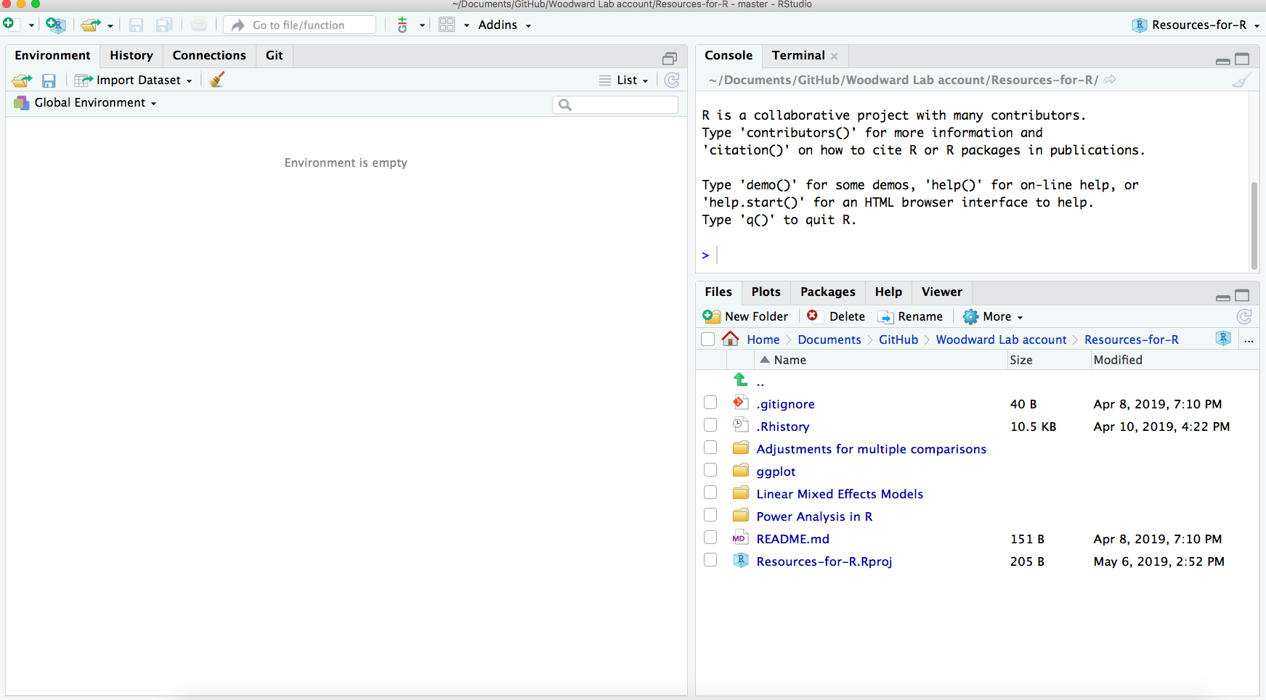
Existing project
You have a Rstuido project that looks like this:
Files that live on your computer

Slide 7
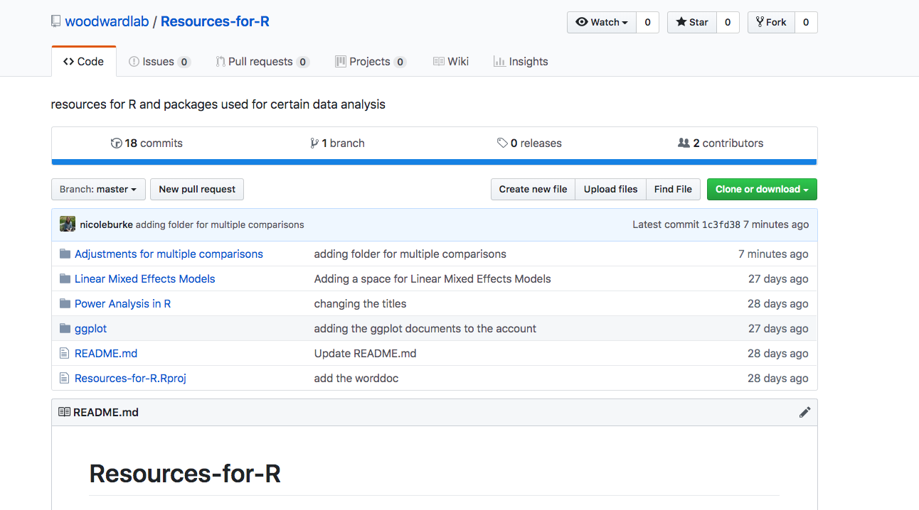
Existing project
You have a Rstuido project that looks like this:
Files that live on Github – they are the same files!
Files that live on your computer - they are the same files!

Slide 8
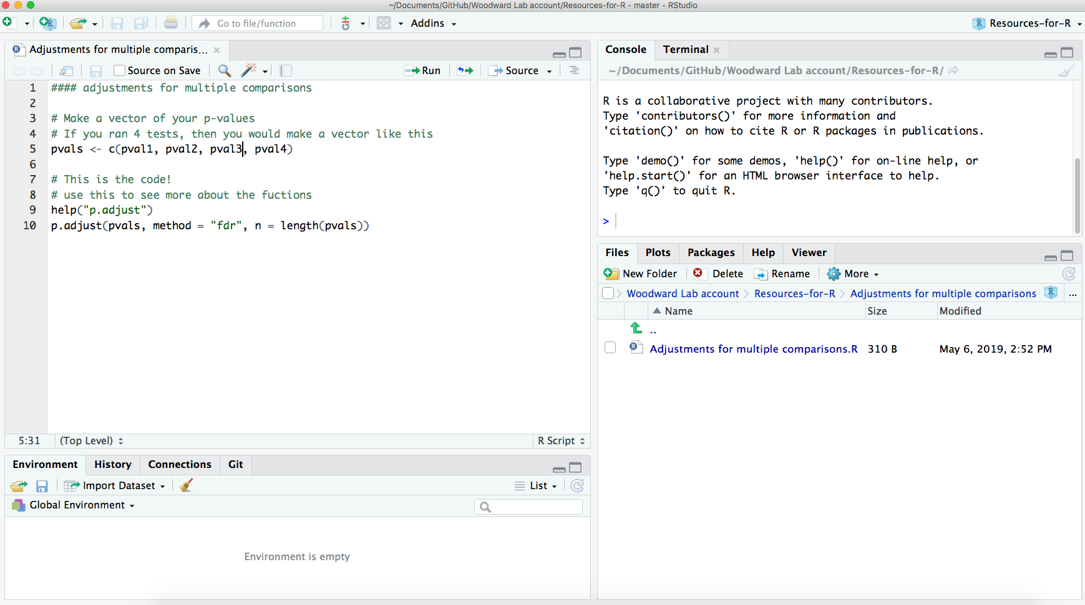
Existing project
You are working on this script and you just made a change. You have saved your file to the local computer, but now you want to upload it to Github.

Slide 9
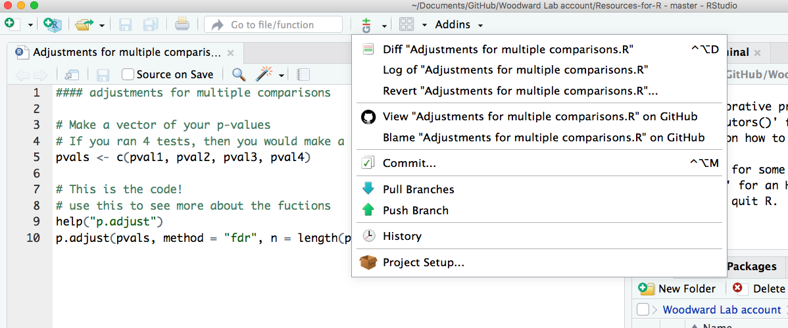
Existing project – make a commit

Slide 10
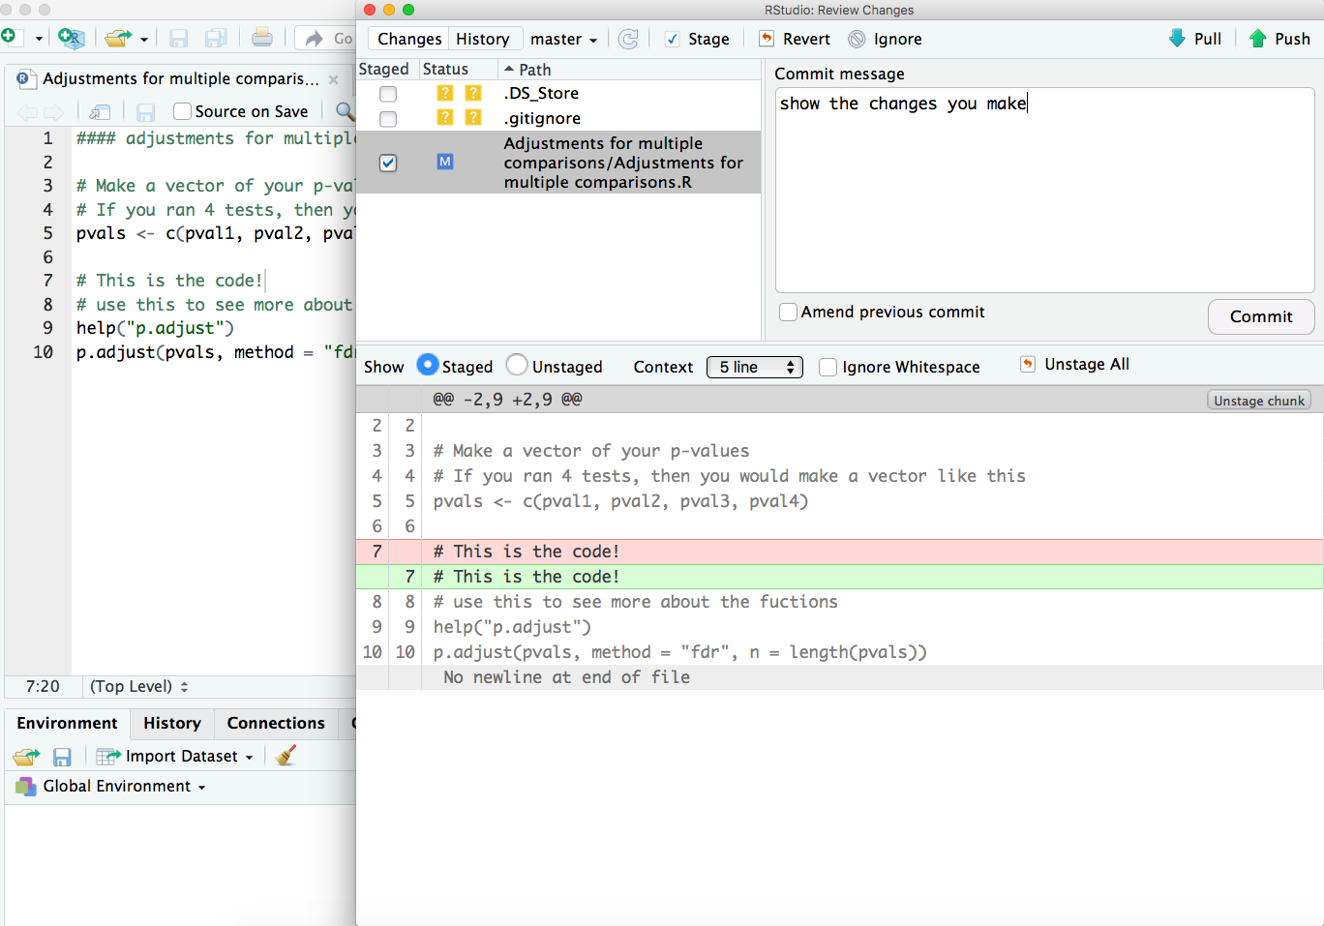
Existing project – make a commit
Then hit push to upload to Github.
Comment here what changes you made.
After you comment, this this button.

Slide 11
Directions for making a git repo from scratch
Is this the best way to do this? Of course not! With R/coding I take the philosophy of an engineer – You do not need to know the best way/how it works, you just need to know that it works and is doing what you want it to!
Efficiency comes with experience and practice.
First, make a new repo on Github.
Then, open a new project is Rstudio.
Select the option about making a new project from a version control directory (Github).
Put in the URL from your Git repo.
You’re done!

Slide 12
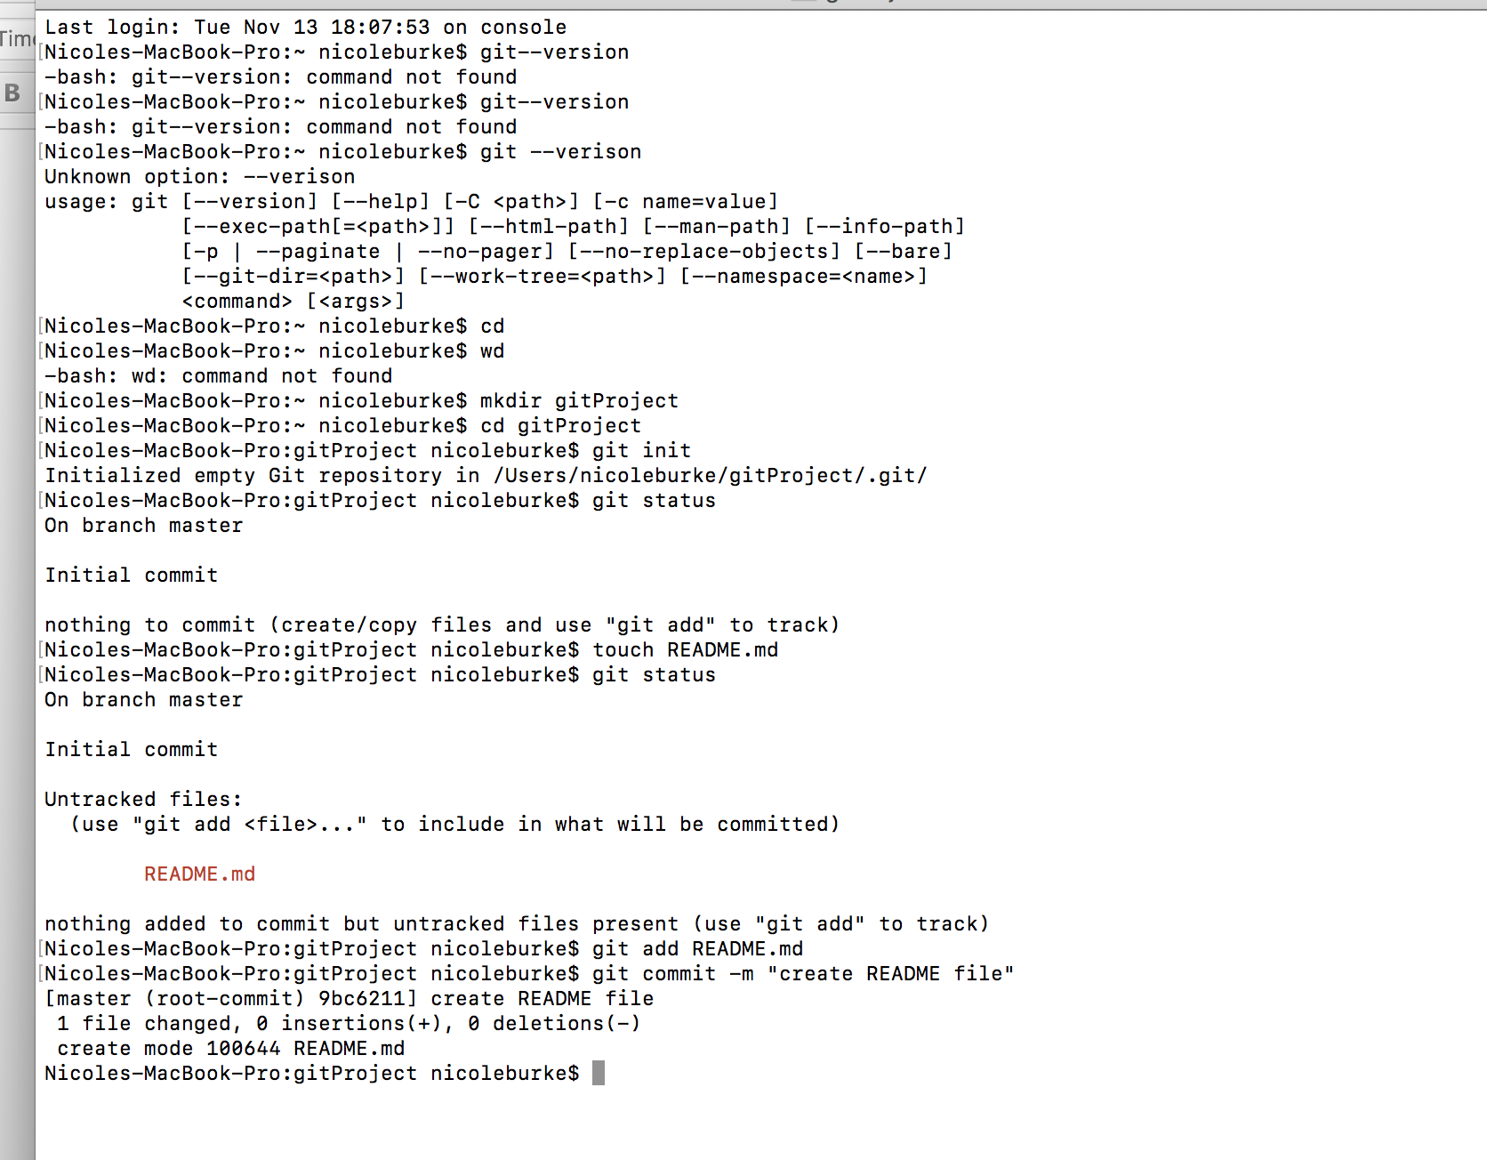
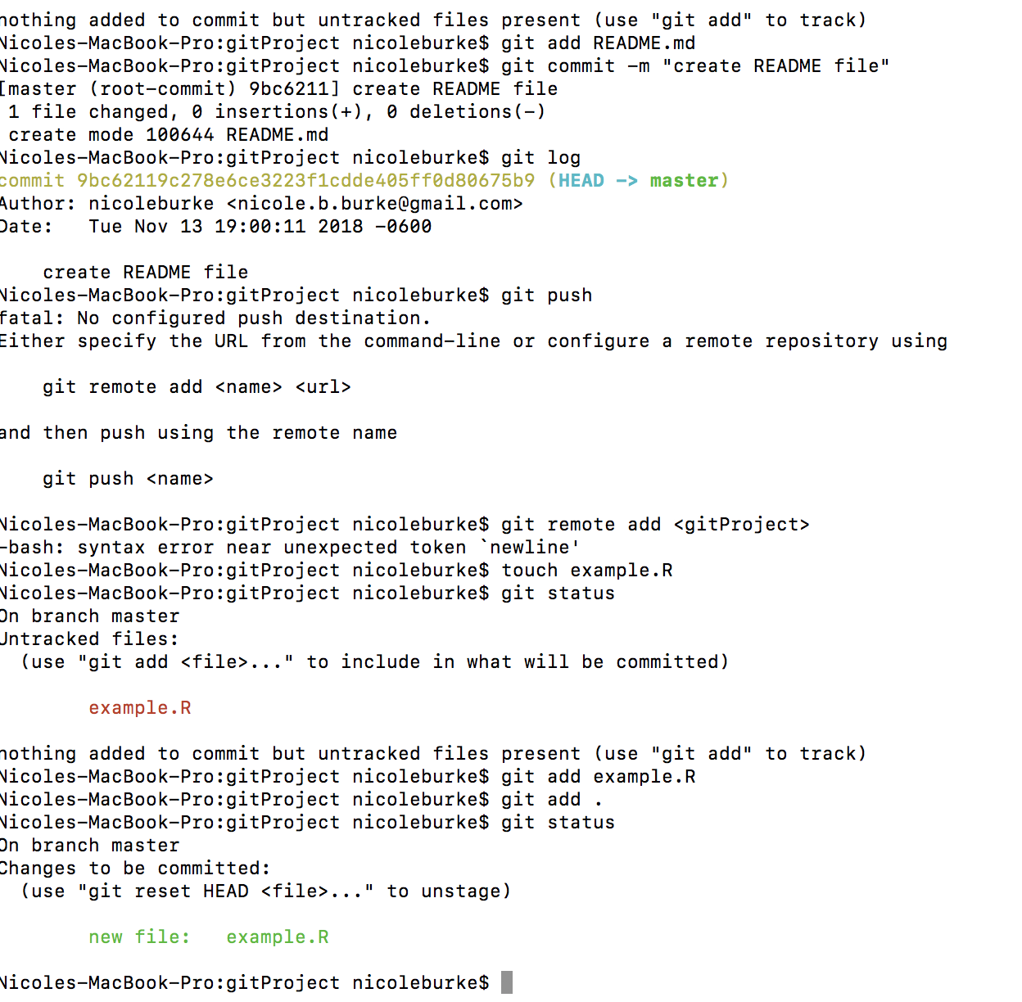
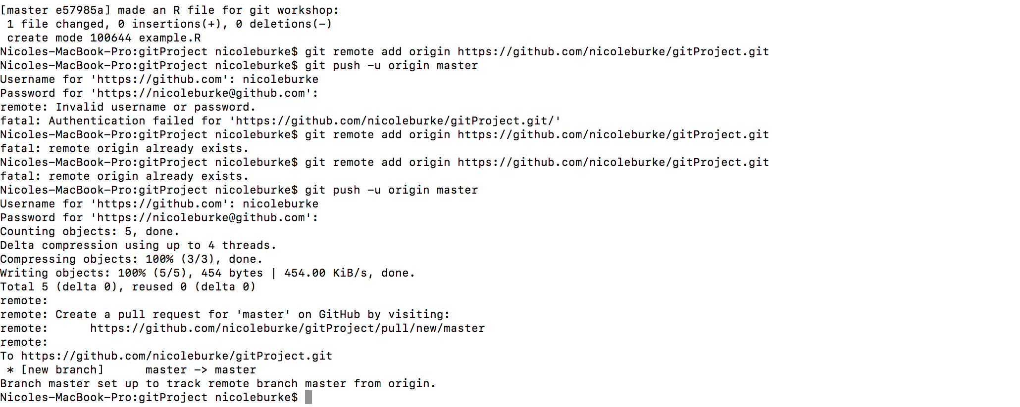
Directions for making this from Terminal
Notes:
My screenshots! I struggled with this, but if anyone wants to do this let’s sit down together and trouble shoot it together.

Slide 13
Github is great for collaboration
This site is a godsend for projects that have multiple people working on it.
I didn’t go into this, but each Git repo has different “branches”. There is the master branch that is the default, but then different users can make their own branches, work on code, and then merge it with the master branch.
Take the P01 – the Woodward Lab (Marlene) could take files and create her own branch, work on code, and then merge it back with the master. All the collaborators would have to agree to the merge before it becomes the default on the master branch. All the while, Git keeps track of version control, so it would be easy to go back to earlier versions and see who did what.
Notes:
I personally haven’t done this yet, but in messing around with it, it seems ~fairly~ simple.

Slide 14
Conclusions
Git/Github is cool!
The best way to learn is to stumble around the internet and then ask people who know it better than you for clarifying questions (how I learned anything in R).
Other best way to learn – go stalk people who do the thing you want to learn about! The best part about this move of open access/transparency – everyone is super open to sharing, so it is easy to gather information.

